Slide 1


Hyundai Nishat Motor (Private) Limited
Department:
PLANT MAINTENANCE
Presented by:
ARHAM ALI

Slide 2

Hyundai's Approach to Plant Maintenance
Definition:
“Maintain a solutions sustainability”
Comprehensive knowledge of the plant
Understanding each process and internal structures
Identifying potential issues
Key role:
The department of plant maintenance emphasizes knowing every detail about the plant to ensure maximum uptime and minimum mean time

Slide 3
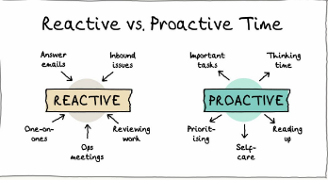
TYPES OF MAINTENANCE
Corrective Maintenance:
Addressing issues as they rise.
Immediate repairs to restore functionality.
Preventive Maintenance:
Routine inspections and maintenance.
Reduces the likelihood of unexpected breakdowns.
Note:
Corrective Maintenance is reactive, while
Preventive Maintenance is proactive.

Slide 4
BODY SHOP
Spot Welding Gun Experience:
During a tour of the body shop, I had the privilege to observe the operation of a spot welding gun.
The spot welding gun is mounted on a balancer, which comes in various weight specifications:
  9-15kg
  15-22 kg
  30-40kg
  40-50kg
  50-60kg
  60-70 kg
  75-90 kg
  85-105 kg
  100-120 kg
The working of the spot welding gun is demonstrated in the next slide alongwith a rough solidworks model.

Slide 5
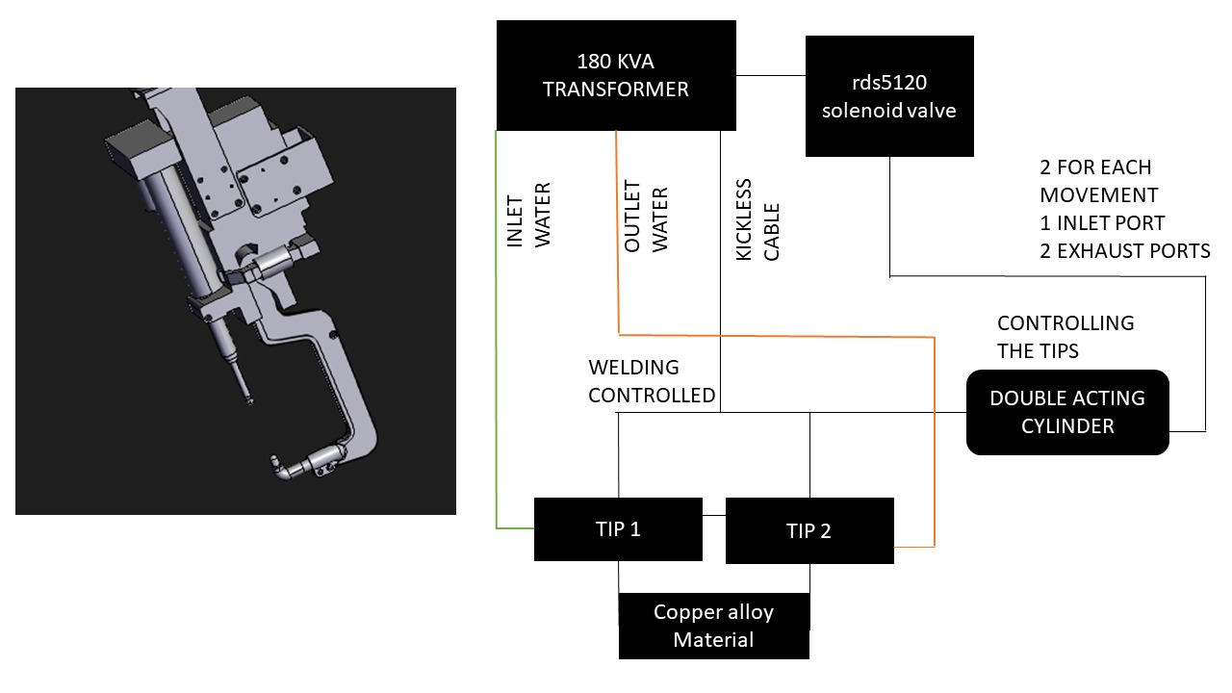
SCHEMATIC OF SPOT WELDING GUN

Slide 6
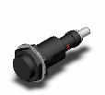

BODY SHOP (cntd)
Automated Spot Welding Gun:
There is an automated spot welding gun used for roof welding, controlled through a PLC (Programmable Logic Controller)
Why automated?
  Automated welding ensures precision and consistency for critical components like roofs.
  Manual welding is used where flexibility and human judgment are necessary for more complex or varied tasks
At the Main Jig:
The main jig is one of the most advanced sections in the body shop, featuring both manual and automated welding processes.
Equipped with 5/2 way 5120 solenoid valves and double-acting cylinders, the motion of the welding guns is precisely controlled.
Inductive E2EF QX7DA proximity sensors are utilized to detect metal (i.e., the car body).

Slide 7
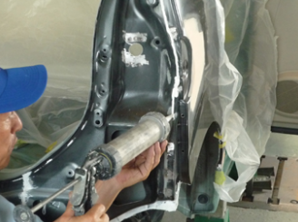
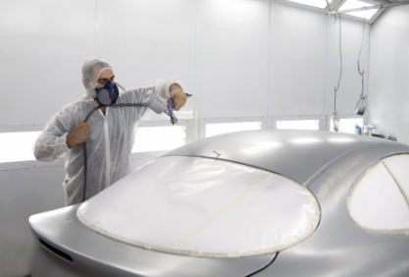
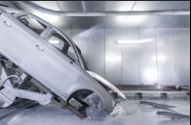
PAINT SHOP
Processes in Paint Shop:
There are many processes in the paint shop some of the highlights are given as:
Inspection
Applying Paint steays
3) PT & ED
Sealer applications
Primer Booth
Top Booth
Waxing

Slide 8
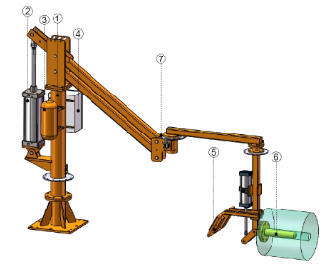
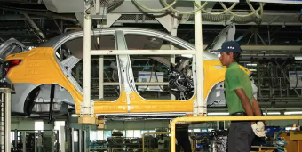
TCF Department Overview
The TCF department consisted of an automated hanger which was taking the body from chassis sub-assemblies. The hanger was automated through PLC and the car was mounted down manually through the hanger's remote.
The final assembly consisted of a PRR 3 DOF manual manipulator which was used in various processes in the final section. The first usage of it was in the tyre fitting section. It had double-acting cylinders attached which were automated in a sense.

Slide 9
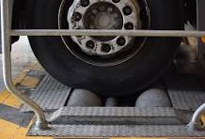
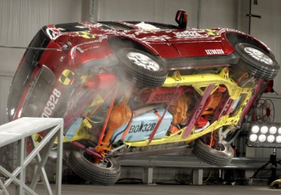
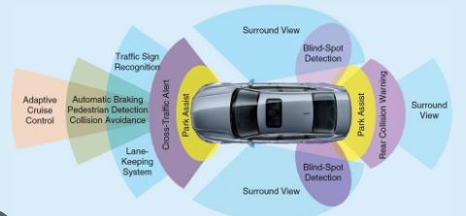
QUALITY CONTROL OVERVIEW
Quality Control Department: Main Maintenance Processes
Brake Test Inspection:
Ensures brake systems function correctly under various conditions.
Roll and Speed Test:
Verifies vehicle stability and speedometer accuracy.
ADAS (Advanced Driver Assistance Systems):
Checks the functionality and reliability of driver assistance technologies.

Slide 10
Project
TEMPERATURE CONTROL OF THE PHOSPHATE PUMP’s MECHANICAL SEAL
WATER TANK
BY: ARHAM ALI

Slide 11
ROUGH SCHEMATIC OF THE WATER TANK
Pressure
sensor
DI Water tank
float
Outlet-valve + pipe
Inlet valve+ pipe
Pump
DRAIN
Recycling

Slide 12
Schematic Diagram of the process
DI WATER TANK
INLET VALVE
OUTLET VALVE
PUMP-2
DRAIN
PHOSPHATE TANK
PUMP-01
RECYCLING
CLOSED LOOP PHOSPHATE SYSTEM

Slide 13
Problem Statement
There is a pump attached to the phosphate water tank which is always working to pump up the phosphate water in the phosphate tank.
The problem arises that the mechanical seal of the pump heats up quickly and requires constant lubrication so that it is always running to its maximum potential and doesn’t breakdown.
To cooldown the mechanical seal and lubricate it there is a water tank in the paint shop which applies constant water supply with some pressure (10 bar) to the mechanical seal to meet its demands.
The water system is a closed loop system which recycles and comes back to the water tank thus minimizing the waste but the problem arises that the temperature of the water tank should not exceed a certain limit (42 degrees Celsius) as it’s function is to cool off mechanical seal.
To maintain the temperature of the water tank a manual system has been installed a worker comes and checks for the temperature of the water and then opens the drain valve and then the inlet valve fills the tank with DI water which stabilizes the tank temperature but it requires some time and being manual work can cause some inefficiencies.

Slide 14
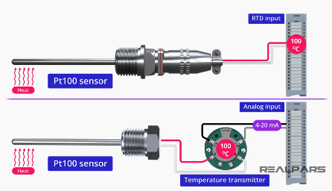

Solution:01 PLC based temperature control
Use temperature sensor (PT100//thermocouple) for temperature measurement.
Use two solenoid valve for the inlet and the outlet flow control
Attach a temperature module on the PLC in the paint shop.
When the temperature exceeds a certain limit (i.e 46 degree celsius)the temperature sensor would send the signal to the module to turn on the inlet and the outlet valve.
The temperature sensor would then send the signal to plc and when the temperature hits 42 degree Celsius it would close both valves.
After some testing we concluded that it takes about 25-40 secs for the water in the tank to drop it’s temperature from 46 degrees to 42 degree celsius

Slide 15
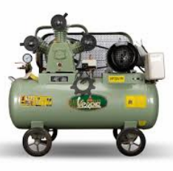
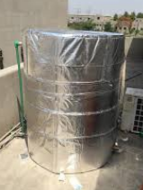
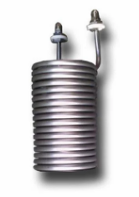
Solution:02 Using Gas circulation system
Insulate the tank with a insulation material
Submerge a heat exchanger in water tank
Add another heat exchanger outside tank
The heat exchangers will be connected with gas pipes thus creating a closed loop system.
Add a compressor to circulate the gas.
Then we can use PLC to control the compressor pressure.

Slide 16
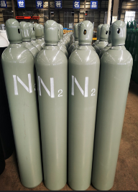
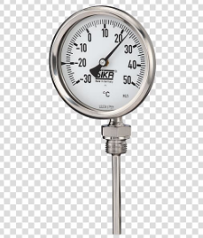
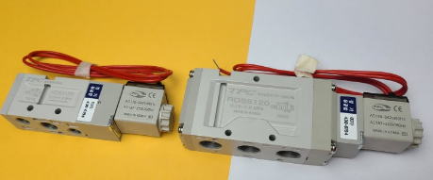
Solution:03 Using a thermocouple
Insulate the tank
Install the bimetallic strip in the water tank and set the desired temperature range.
Install solenoid valve in the gas supply line and attach it to the thermostat
Now connect the nitrogen gas to the solenoid valve.
When the temperature increases a certain limit the thermostat coils up and energizes the solenoid valve.
This gas will continue until the temperature reaches a certain limit .
For precautions we can set the temperature limit range to be pretty low 2-5 C so that nitrogen gas loss is minimum.

Slide 17
Comparison of Solutions
Feature | Solution 1: PLC based temperature control | Solution 2: Heat Exchanger Loop | Solution 3: Bimetallic Thermostat & Nitrogen Purge
Cost | Low (uses standard components and plc is already available) | Moderate (requires heat exchangers, compressor, piping) | Low-Medium (uses bimetallic strip, solenoid valve, nitrogen)
Efficiency | Low (wastes water, energy to heat new water) | High (closed loop, precise control) | Moderate (controls temperature but loses some heat)
Maintenance | Moderate (requires cleaning sensors, valves) | High (requires maintaining heat exchangers, compressor) | Low (relatively simple system)
Complexity | Low (uses basic control logic) | High (requires complex control of compressor pressure) | Moderate (needs thermostat calibration)
Suitability for Large Tanks | Not recommended (wastes too much water) | Best option (efficient, scalable) | May not be powerful enough for very large tank

Slide 18
SUITABLE SOLUTION
Based on the criteria of being inexpensive and efficient, Solution 2: Heat Exchanger Loop is the best option.
It offers precise temperature control with a closed loop system, minimizing water waste and energy consumption.
But for smaller tanks (in our case) Solution 1: Drain & Refill or Solution 3: Bimetallic Thermostat & Nitrogen Purge

Slide 19
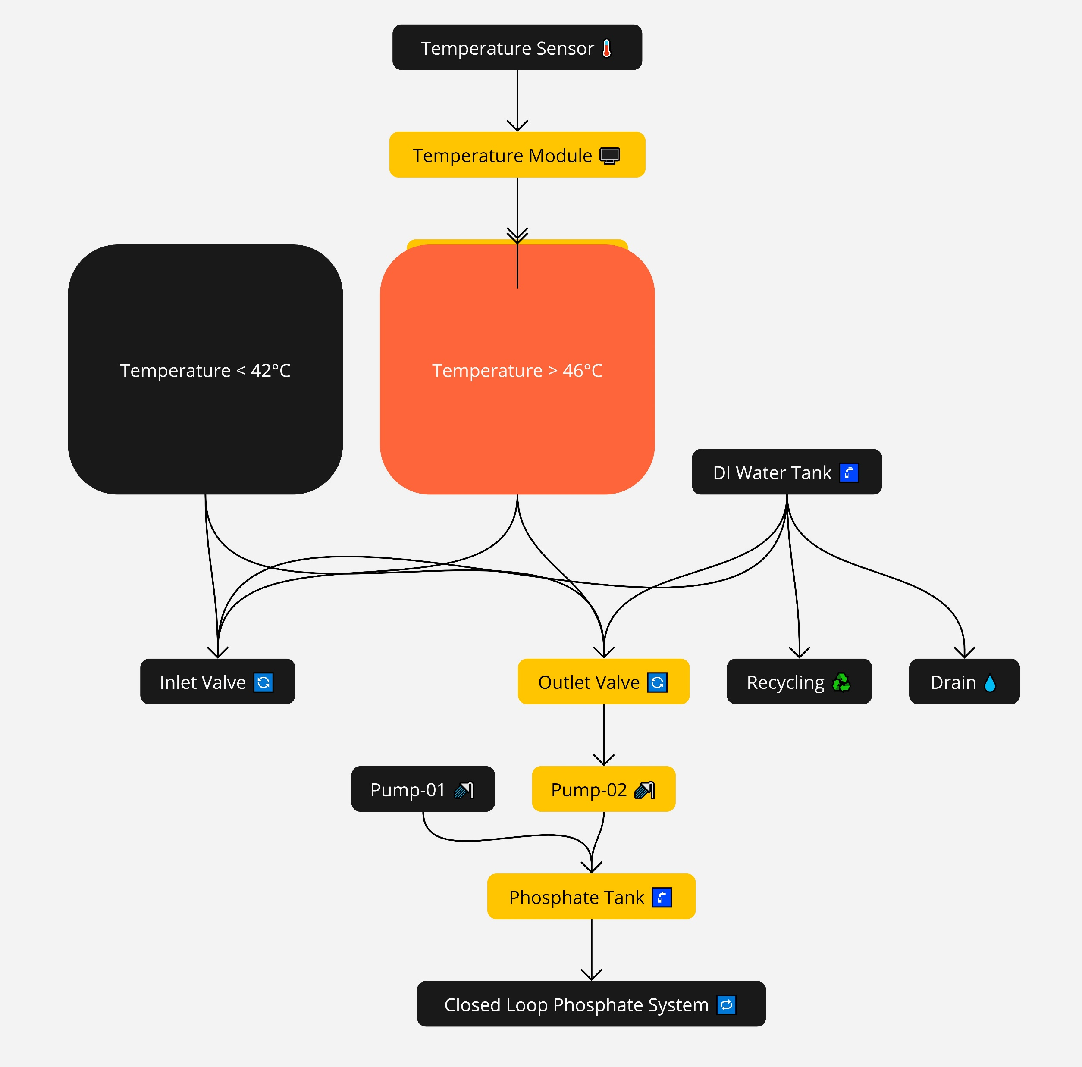

Slide 20
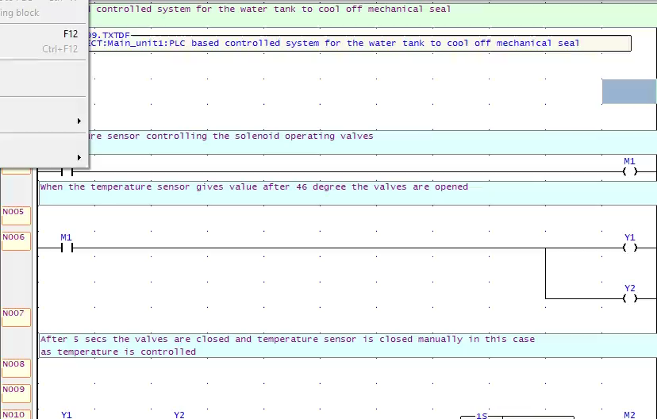
Demonstration of the solution:01 in PLC software

Slide 21
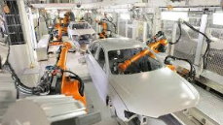
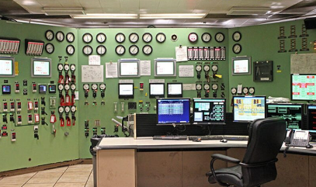
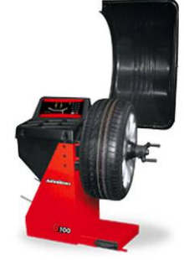
RECOMMENDATIONS
Robotic manipulator in paint shop atleast
A control room to communicate to the leaders/supervisor about any problem if it occurs.
Make the body shop’s main jig of DN8 and AD fully automated.
Make the process of john bean wheel balancer fully automated.

Slide 22
ANY QUESTIONS?

